Slide 1



AMEA Union orientation
Notes:
I am a rep here and welcome you to the muni and to go over the orientation packet, the benefits of being a member. First let me tell you about the

Slide 2

WELCOME TO THE
MUNICIPALITY OF ANCHORAGE!

Slide 3


Please Introduce yourself
What is your name?
What department are you going to work for?
Why did you choose the MOA?
This Photo by Unknown Author is licensed under CC BY
Notes:
Thank you for giving me your fishing spot

Slide 4

new employee orientation
AMEA attends new employee orientations to give you a general overview about your union rights and to let you know that you have union representatives available to give you information and help any time. We hope and encourage new members to become active participants in our association.
AMEA is a collective bargaining unit which represents a broad group of Anchorage Municipal employees who provide a wide array of essential public services vital to the daily operation of the city and the safety & well-being of Anchorage residents.
AMEA will provide a new employee orientation packet to all new members via email. It will include various documents for you to review, as well as this PowerPoint presentation.

Slide 5
AMEA History
Anchorage Municipal Employees Association (AMEA) organized in 1971.
In 2014 AMEA members voted to approve an affiliation agreement with the American Federation of State, County and Municipal Employees (AFSCME), the largest Public Service member organization under the AFL-CIO.
AMEA is comprised of nearly 500 Municipal Employees.
Notes:
Take out the caps

Slide 6
What is AMEA?
AMEA is a public employee union.
A union is an organization that acts as an intermediary between its members and the organization or agency that employs them.
Unions give workers the power to negotiate for more favorable working conditions, wages, benefits, workplace health and safety, and other benefits through collective bargaining.
Unions help to make sure that management acts fairly and treats its workers with respect.
Notes:
Which basically means if we stand together as a union we can get a better collective bargain

Slide 7
Orientation PACKET
Welcome letter from AMEA Board
Weingarten Rights Card
Payroll calendar for the year (2021)
List of AMEA Committees
AMEA Bylaws and a meeting schedule for the year
List of AMEA officers and shop stewards, and their contact information
AMEA text message sign up application
AFSCME benefit literature/pamphlets.
AMEA membership application that must be completed online (https://www.ameatoday.org/become-member)

Slide 8
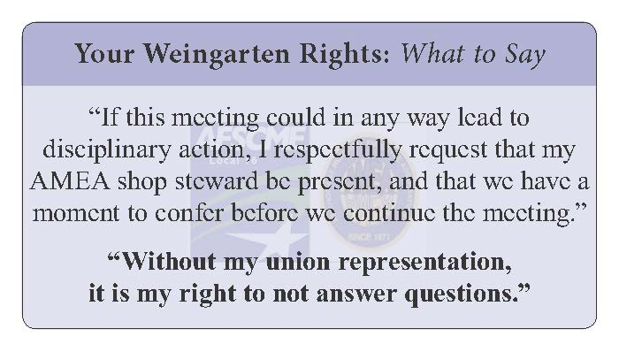
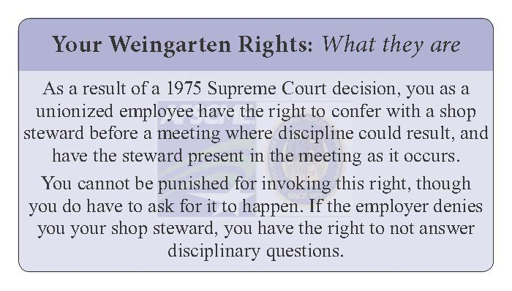
Weingarten card
You have the right to talk with your shop steward before any meeting where discipline could result.
You are entitled to request that a union representative be with you in any disciplinary meeting.
There are specific words you should say to make your request clear.
Keep this card with you in case you need it.
Notes:
When you are trying to work with management to make sure you are fairly representation. We have your back when there is a problem that you cannot handle.
If you don’t ask for it you don’t get—you have given up your right.

Slide 9
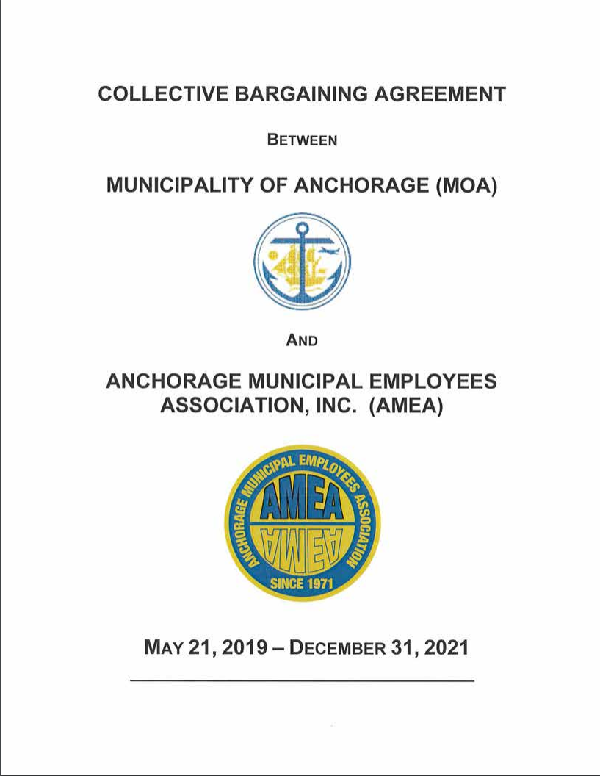
Knowledge is POWER
Do you ever wonder:
How much leave will I get per paycheck?
What will be my pay after 4 years?
Can I get leave time for donating blood? For voting?
What are my options if there is a problem with my paycheck?
How does progressive discipline work? How does the union protect me?
What is a Grievance?
Read the contract.
Get more knowledge at the AMEA website:
https://www.ameatoday.org/get-new-contract
Notes:
Hour and work rules

Slide 10
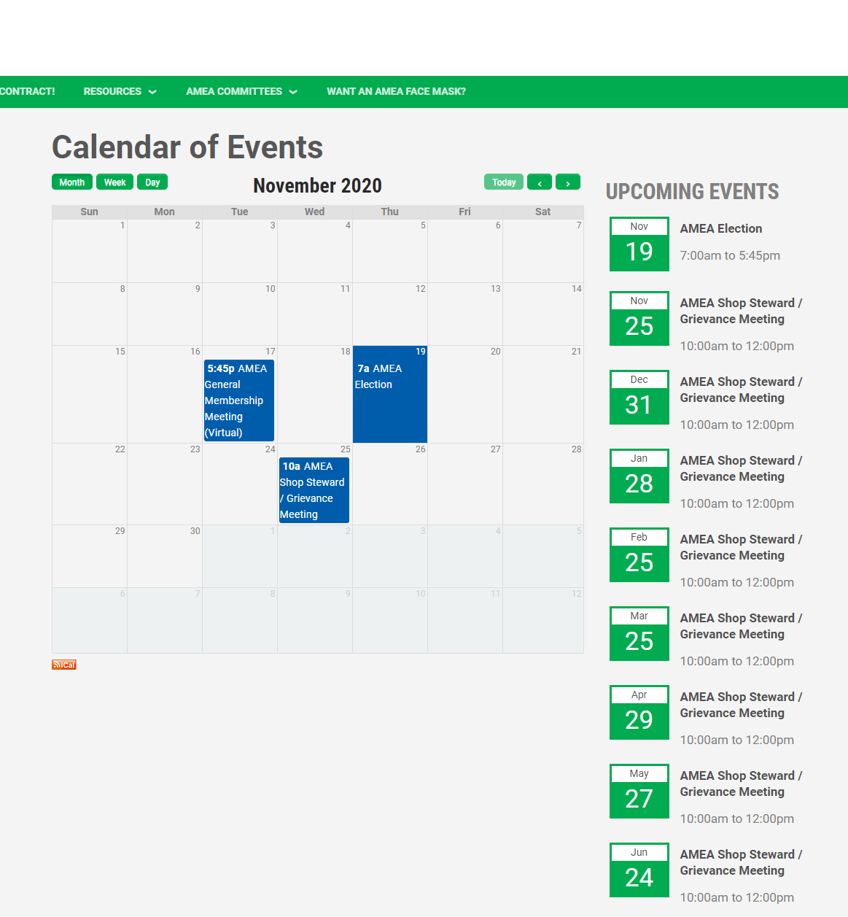
Union meetings
The union meets once a month.
The union cannot provide meaningful representation if you do not explain or communicate your problems.
We need your input; we always want new ideas
Learn more about your fellow union workers
Take advantage of networking opportunities
Find out when our meetings are:
https://www.ameatoday.org/calendar-events
(Please note all meetings are currently using Zoom.)
Notes:
On the amea website
The union meets twice a month and we would like to get a quorm which needs 10 times a month.
Hour paid work
Like there suggestion
And input
We can't rep you well if we don’t know what your problems is
Find election days

Slide 11
Summary of your packet
If you lose or misplace anything in your packet, you can download any of the documents from the amea website.
www.ameatoday.org
Questions
Notes:
If you have lost anything from your welcome packet, you can download any of them at the website.
Welcome letter from AMEA Board
Weingarten Rights Card – if you have a problem
Contract benefit overview document
Payroll calendar for the year
Committee list for this year
AMEA Bylaws and a meeting schedule for the year
Contact list of AMEA officers and shop stewards
AMEA dues check-off form/membership application that must be completed online (https://www.ameatoday.org/become-member)
AMEA text message update flyer
AFSCME benefit literature/pamphlets.

Slide 12
Name one thing you will get in your orientation packet
QUIZ TIME!!!
Notes:
Welcome letter from AMEA Board
Weingarten Rights Card
Contract benefit overview document
Payroll calendar for the year
Committee list for this year
AMEA Bylaws and a meeting schedule for the year
Contact list of AMEA officers and shop stewards
AMEA dues check-off form/membership application that must be completed online (https://www.ameatoday.org/become-member)
AMEA text message update flyer
AFSCME benefit literature/pamphlets.

Slide 13
WIFM
Membership benefits
Confused about the bargaining agreement?
Represent you if you face discipline
Discounts:
Free college benefits
Scholarships
AFSCME Advantage Auto Buying
Cell phone service discount
Pet services
Legal services
And more…
Notes:
Now let me just review what membership benefits you get
You have rep and a voice and explain to you about the bargain unit…work hour, work conditions you have a person to call if you have a question about the union
Sell the union/cost
For you to be part of the union there are dues:

Slide 14

What are my union dues?
Your union dues depend on how many hours you work per week:
  Full Time Employees $ 18.00 per pay period
  Part Time Employees $ 13.50 per pay period
  Fewer than 12 hours $ 9.00 per pay period
There is a one-time initiation fee of $25.
(If rehired within 1 year, the fee is waived.)
Notes:
Let me tell you what the dues are
From dues let me show you how to be a member of the union
Auto taken from you pay check
https://www.ameatoday.org/news/new-dues-rate-implementation

Slide 15
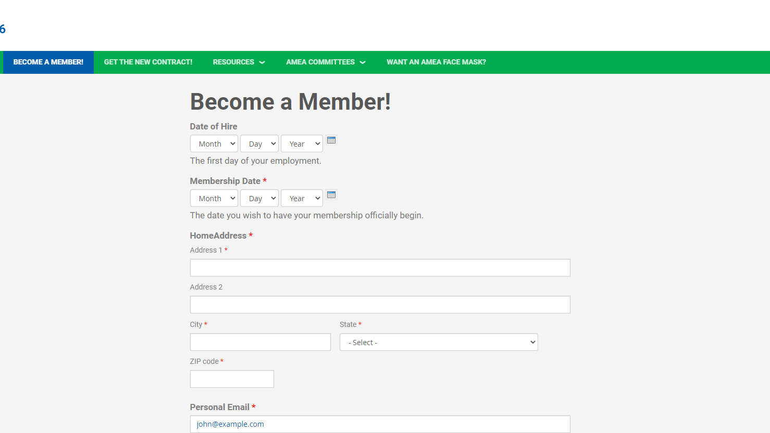

Membership application
Complete it on-Line at:
Sign Up and Join AMEA
www.ameatoday.org/become-member
Notes:
Here is what your membership application looks like
We want to make sure we ep you and this is how you become a member.
Let me show you how to bill your time.

Slide 16


Follow us on Social media for regular updates and amea information!!
@amealocal16
AMEA – Anchorage Municipal Employees Association AFSCME Local 16

Slide 17

Completed orientation
Congratulations, you have completed Orientation
Thank you for your time and attention
We are here for you!

